Slide 1
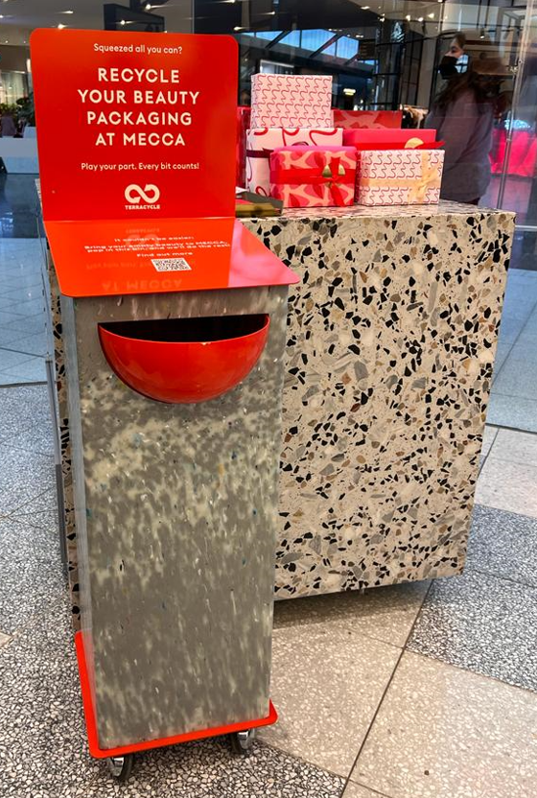
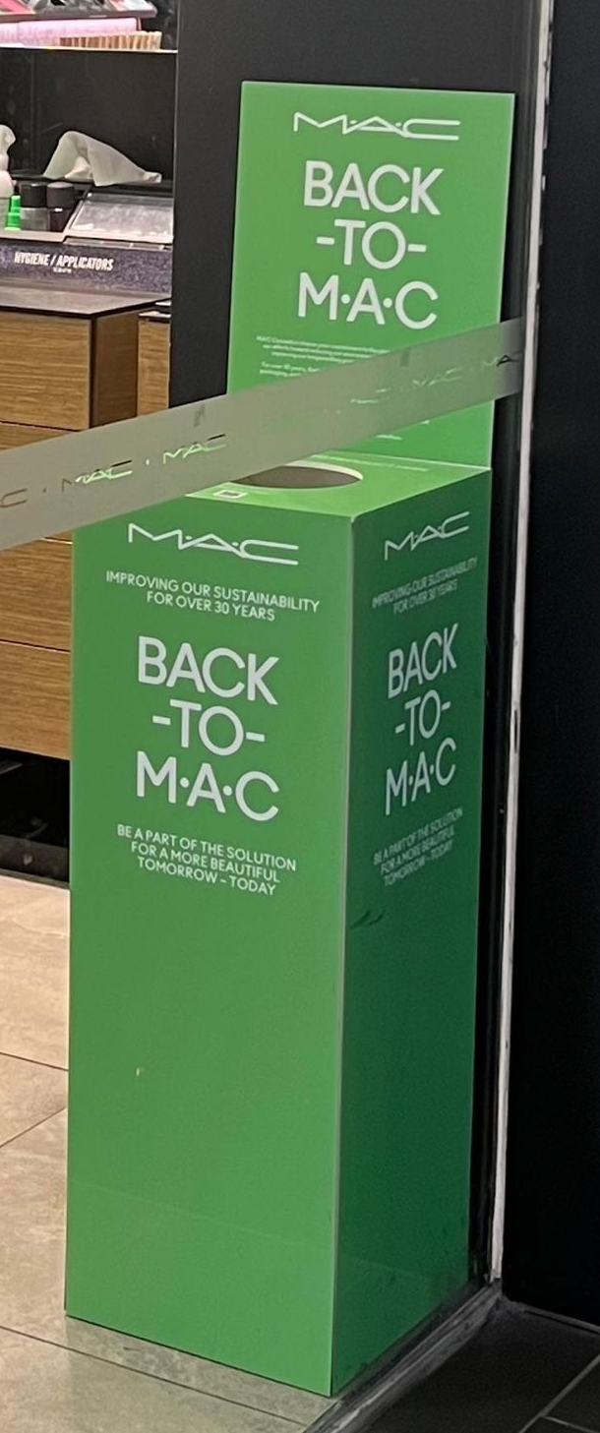

Sustainable Materials Retail Display POS
Sustainability is always factored into our design thinking.
During every step of our design process, we consider;
material selection,
recyclability,
durability and
responsible production
And recommend smarter material choices and design solutions that help reduce waste and environmental impact.
We understand that our clients and your consumers expect more sustainable choices, and we are committed to finding practical ways to deliver beautiful, effective displays with a lighter footprint.

Slide 2
