Slide 1
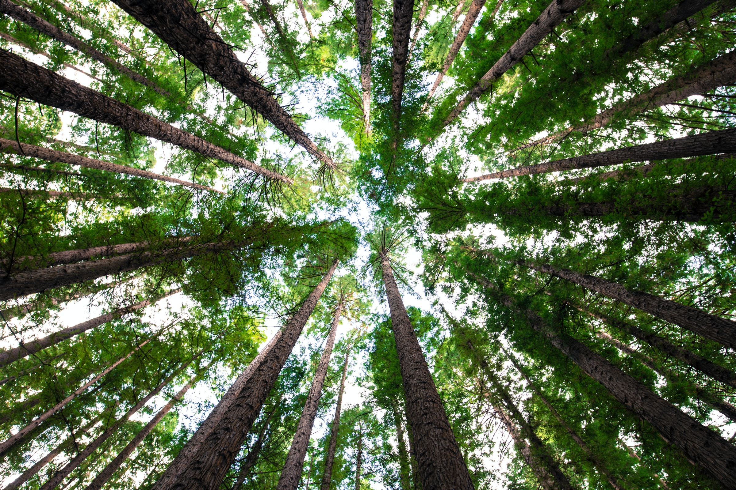
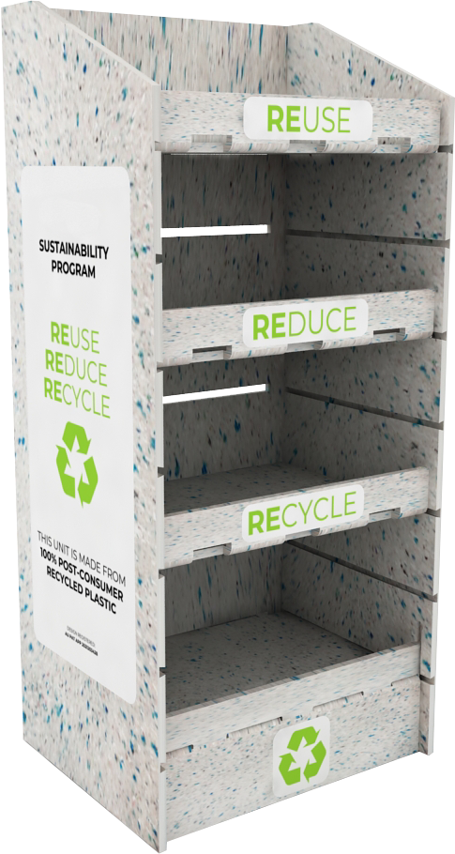

Enviro OFD

Slide 2
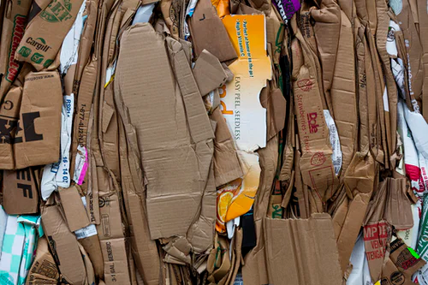
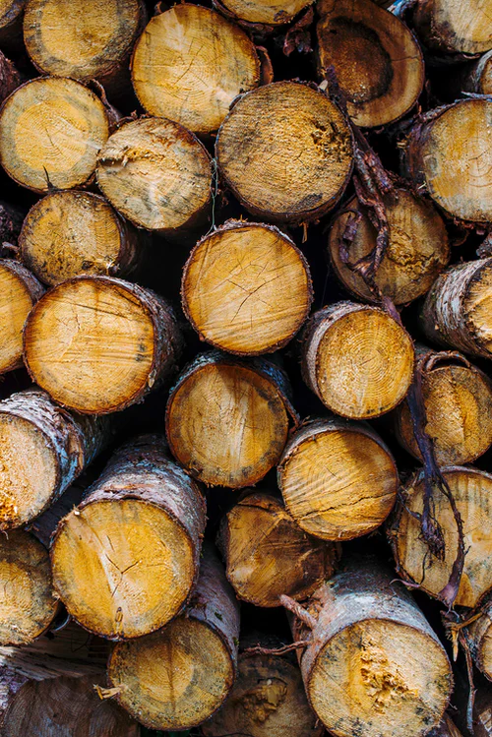
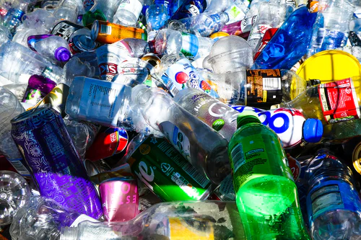

Did you know ?
1 Billion
180 Million
6 Million
Kilograms of cardboard is used in retail displays every year
Trees are processed to create a billion kilograms of cardboard
Tonnes plastic packaging go landfill every year in Australia
All rights reserved to UFO Display Solutions. No part of this document or design concepts can be reproduced by any means,
nor disclosed to any third party without the consent in writing of UFO Display Solutions.

Slide 3
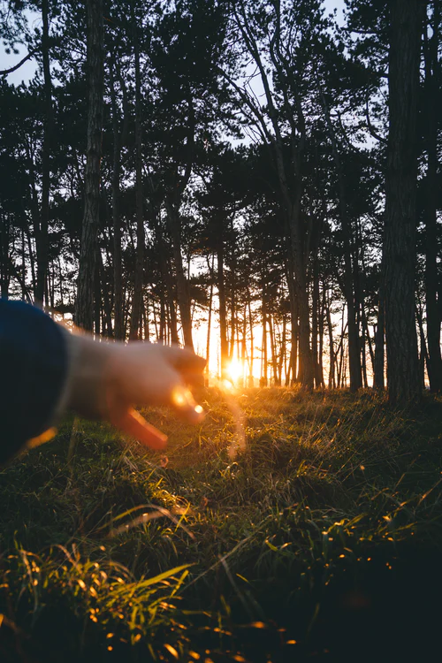
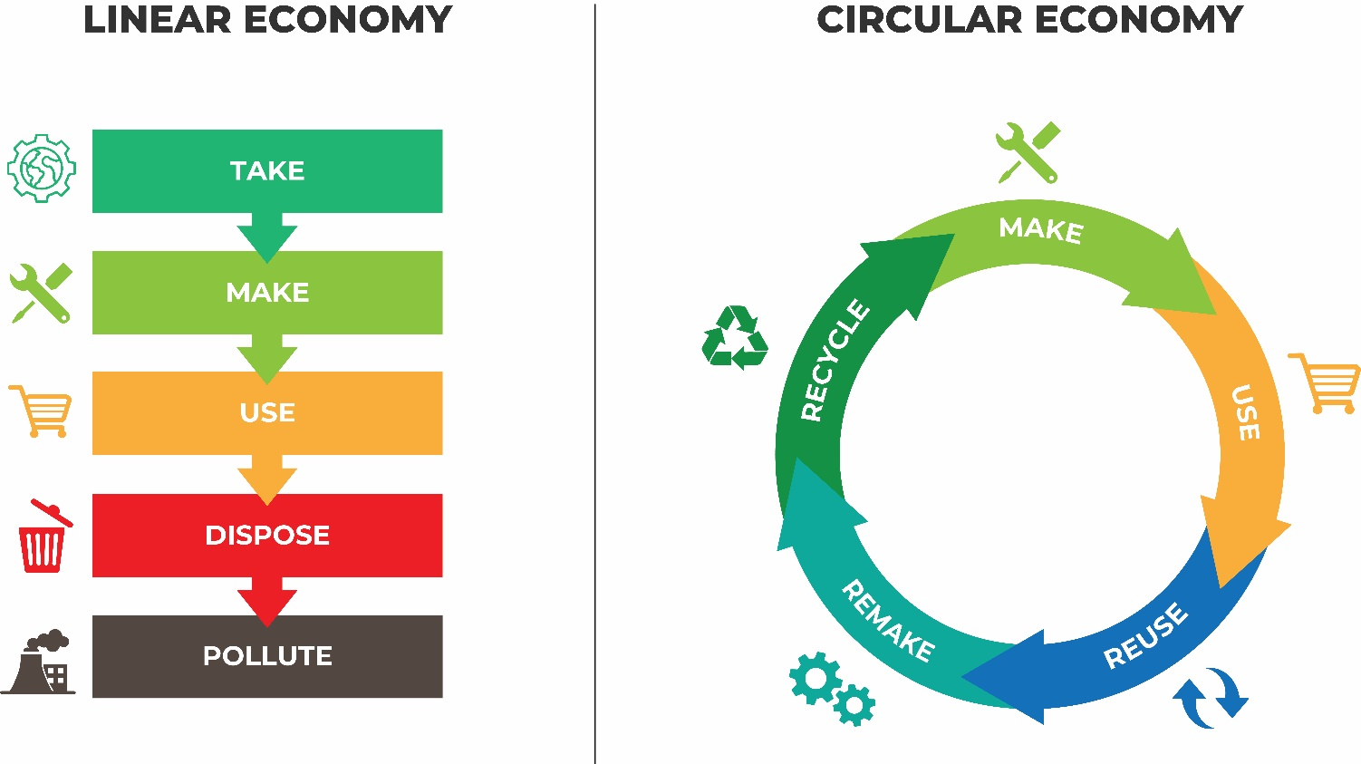
The Circular Economy
Eliminating the current linear economy is creating
a sustainable and socially responsible circular economy.
We need to
make change
By preserving our environment
by changing the way
we do business
All rights reserved to UFO Display Solutions. No part of this document or design concepts can be reproduced by any means,
nor disclosed to any third party without the consent in writing of UFO Display Solutions.

Slide 4

52% of millennials and 48% of Gen Xers feel it is important that their values align with the brands they like.
35% of baby boomers surveyed felt the same way.
Retailers and Brands, focusing on sustainable practices is not only crucial to protect the environment but also, a keyway to attract younger generation.
Facts
A 2018 survey from
data platform Euclid
All rights reserved to UFO Display Solutions. No part of this document or design concepts can be reproduced by any means,
nor disclosed to any third party without the consent in writing of UFO Display Solutions.

Slide 5
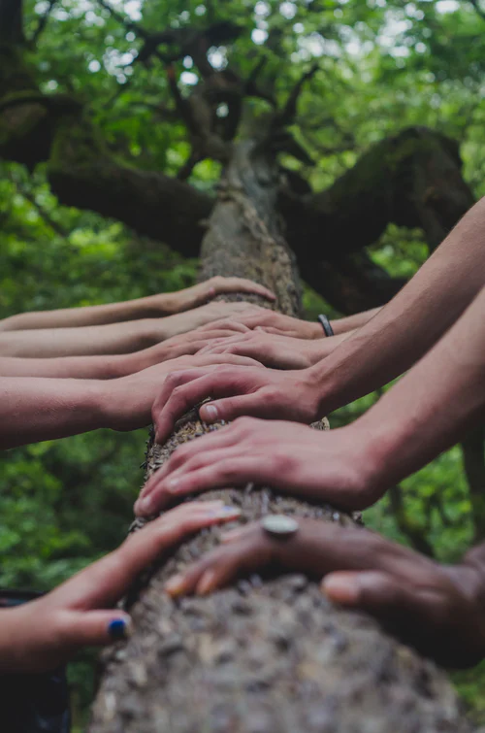

By making use of our patented Australian designed (Enviro OFD) made from Australian sourced post consumer waste (PCR-1) material can make a significant difference to the environment. AU Pat App 2021203428
With the ability to be rebranded with recycled material
and printed with environmentally friendly vegetable based inks, truly provides a long term circular economy.
AU Des. Appln. Nos. 202112957 & 202112957
What is a solution?
Post-Consumer Recycled
(PCR) HDPE
Proudly Australian Designed, Made using Australia material
All rights reserved to UFO Display Solutions. No part of this document or design concepts can be reproduced by any means,
nor disclosed to any third party without the consent in writing of UFO Display Solutions.

Slide 6
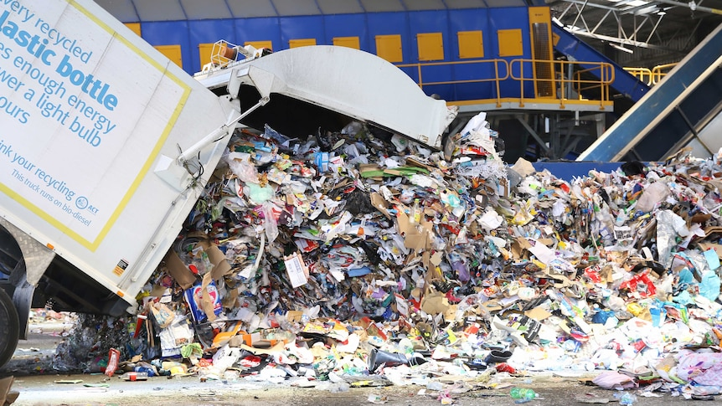
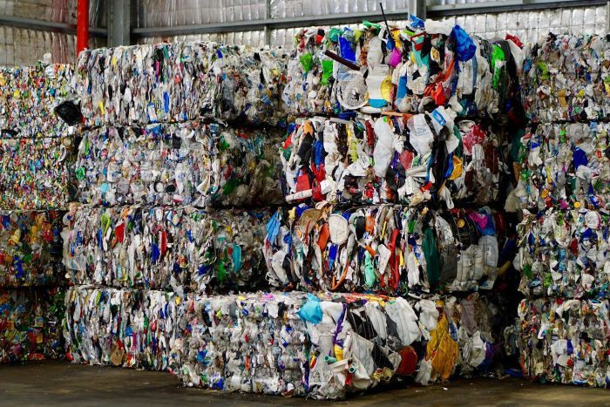
Introducing Post-Consumer Recycled (PCR) HDPE
Collections from Australian homes
In 2017-18, we used some 3.4 million tonnes of plastics in Australia. Just 9.4% - 320,000 tonnes - was recycled.
Post-Consumer Recycled (PCR) HDPE
sheets are made from 100% Post Consumer Plastic waste.
(PCR) Raw compound
The waste materials go through a
sorting and Cleaning process and are then heated and formed
into flat panels.
All rights reserved to UFO Display Solutions. No part of this document or design concepts can be reproduced by any means,
nor disclosed to any third party without the consent in writing of UFO Display Solutions.

Slide 7
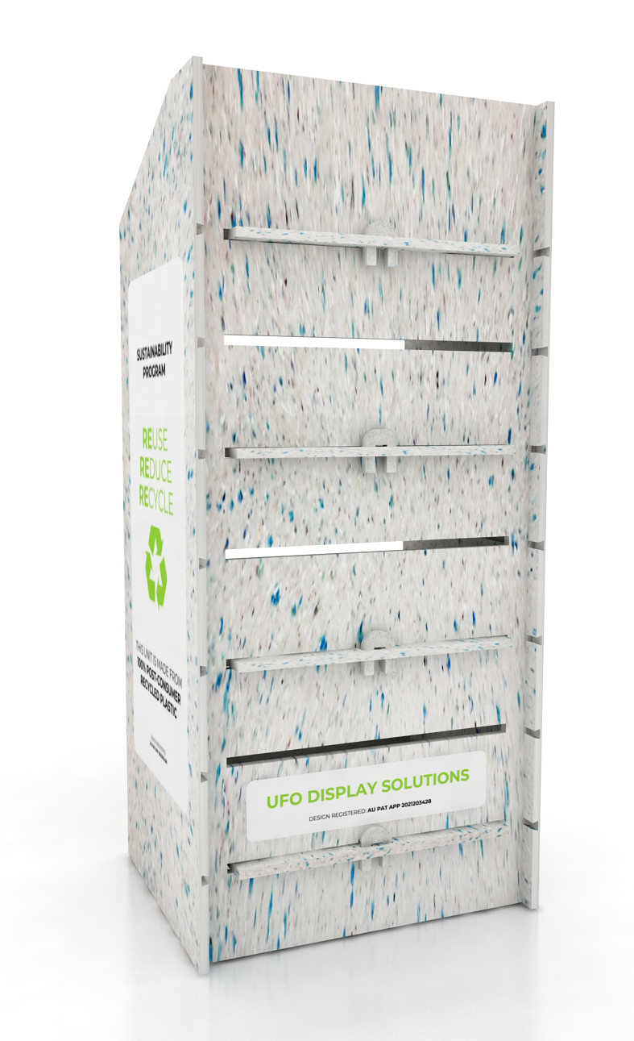
Enviro OFD Naked
Australian Design & Manufactured
Made from 100% Australian Post-Consumer Recycled material PCR 1
Supplied & store as a flat pack
Customised footprint to meet your requirements
Shelf adjustability with our unique construction method
PCR 1 is extremely strong and robust with the ability to hold excessive weight
Easily relocatable
Ease of assembly no tools required
Water resistant and easily maintained
Enviro OFD and (DUK) is 100% recyclable
Prolonged life expectancy compared to standard carboard OFD
AU Pat App 2021203428
All rights reserved to UFO Display Solutions. No part of this document or design concepts can be reproduced by any means,
nor disclosed to any third party without the consent in writing of UFO Display Solutions.

Slide 8
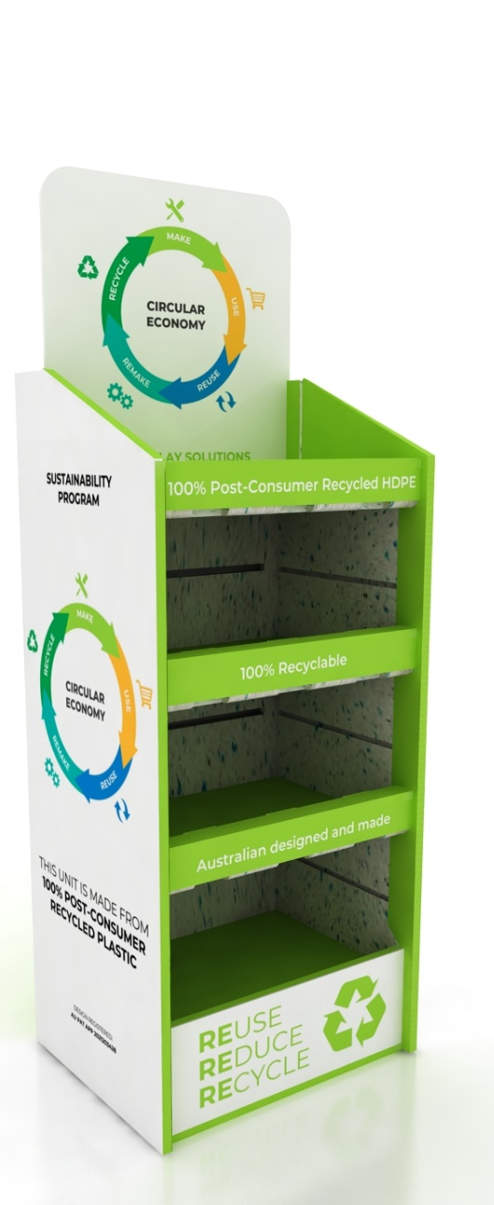
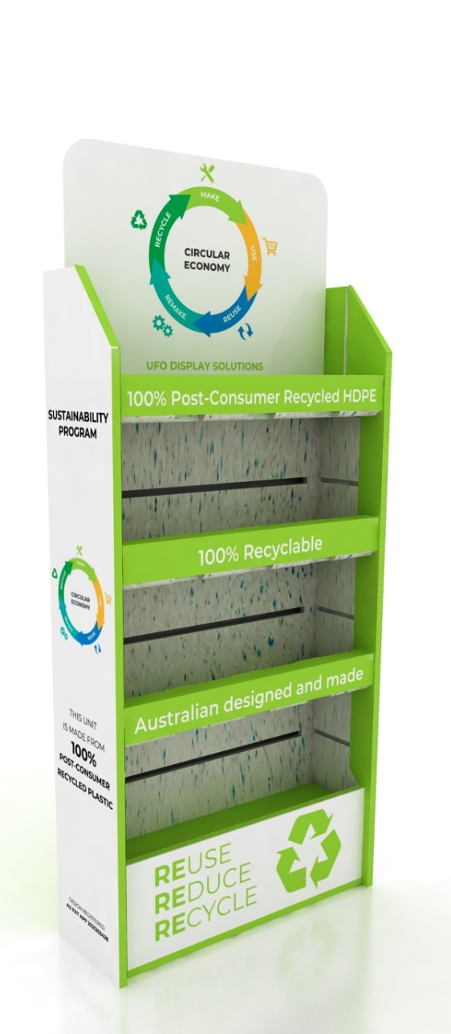
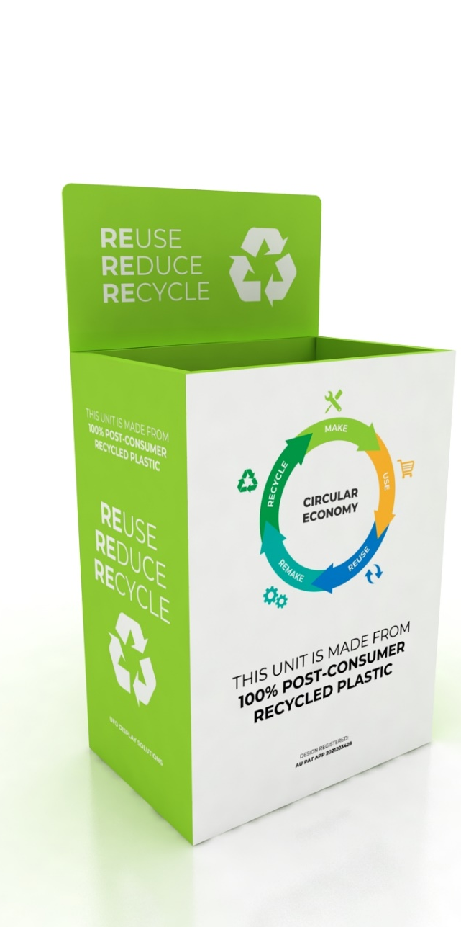
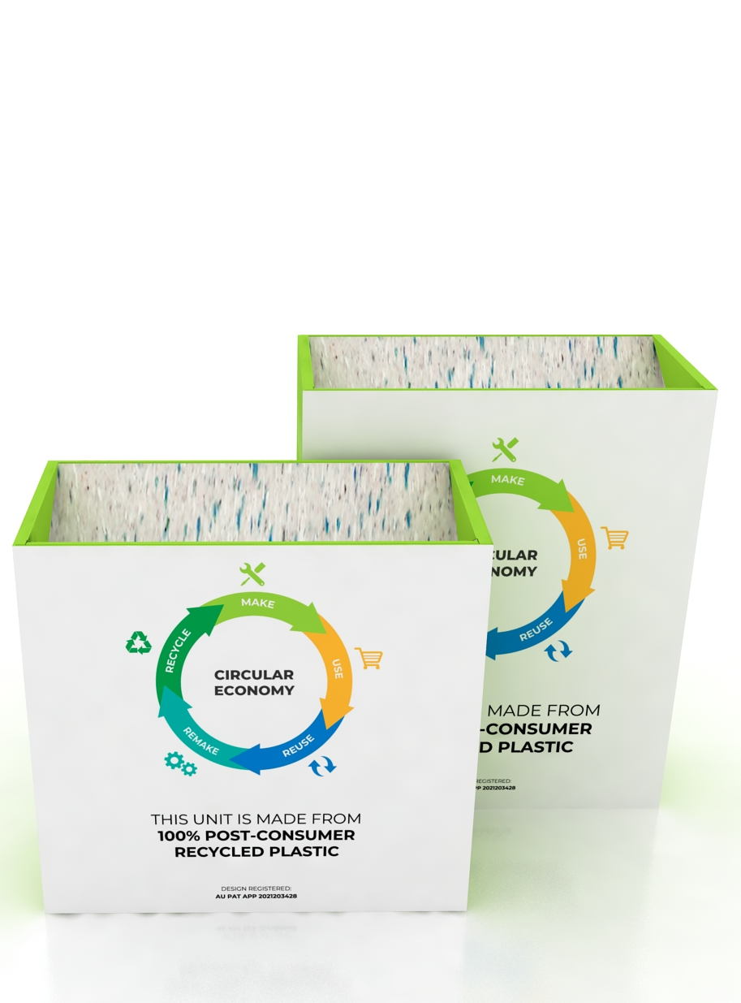
Enviro OFD
Standard OFD
500Wx400Dx1400
(header included)
Skinny OFD
600Wx200Dx1370H
(header included)
Dump Bins Options
650Wx430Dx1240H (header included)
800Wx340Dx800-1000H
All rights reserved to UFO Display Solutions. No part of this document or design concepts can be reproduced by any means,
nor disclosed to any third party without the consent in writing of UFO Display Solutions.

Slide 9
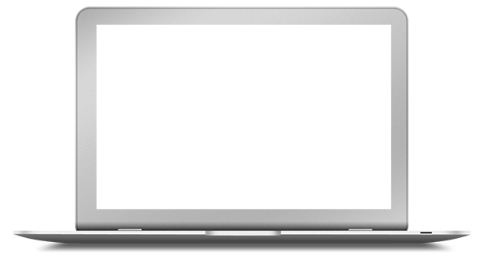
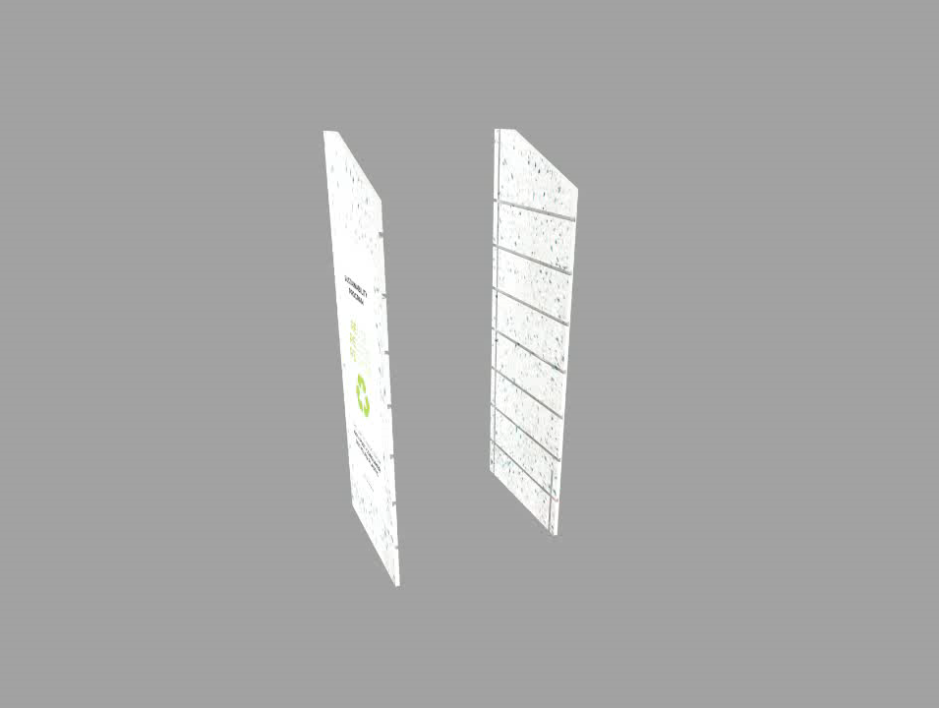
Enviro OFD Assembly Animation
AU Pat App 2021203428
All rights reserved to UFO Display Solutions. No part of this document or design concepts can be reproduced by any means,
nor disclosed to any third party without the consent in writing of UFO Display Solutions.

Slide 10
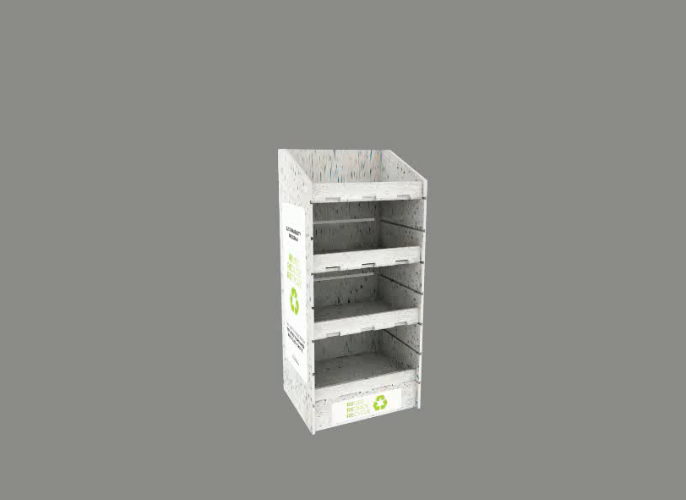
Enviro OFD Rebranding Animation Naked Back
AU Des. Appln. Nos. 202112957 & 202112957
All rights reserved to UFO Display Solutions. No part of this document or design concepts can be reproduced by any means,
nor disclosed to any third party without the consent in writing of UFO Display Solutions.

Slide 11
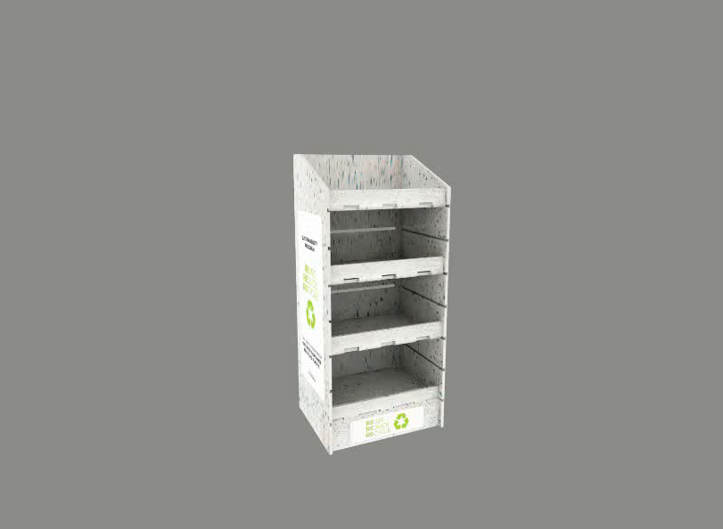
Enviro OFD Rebranding Animation Full Dressed
AU Des. Appln. Nos. 202112957 & 202112957
All rights reserved to UFO Display Solutions. No part of this document or design concepts can be reproduced by any means,
nor disclosed to any third party without the consent in writing of UFO Display Solutions.

Slide 12
Enviro OFD Rebranding Process
Retailer
Direct
to Store
UFO will provide
the following services:
Receipt of artwork from Retailer/FMCG/Design studio
Pre-flights artwork to make sure the artwork is correct
Print wrap to ensure recycled integrity
Tracks specific delivery location
FMCG
Direct to Distribution Centre
Design studio
Direct
to Merch
Others
Merchandise services
All rights reserved to UFO Display Solutions. No part of this document or design concepts can be reproduced by any means,
nor disclosed to any third party without the consent in writing of UFO Display Solutions.

